Slide 1
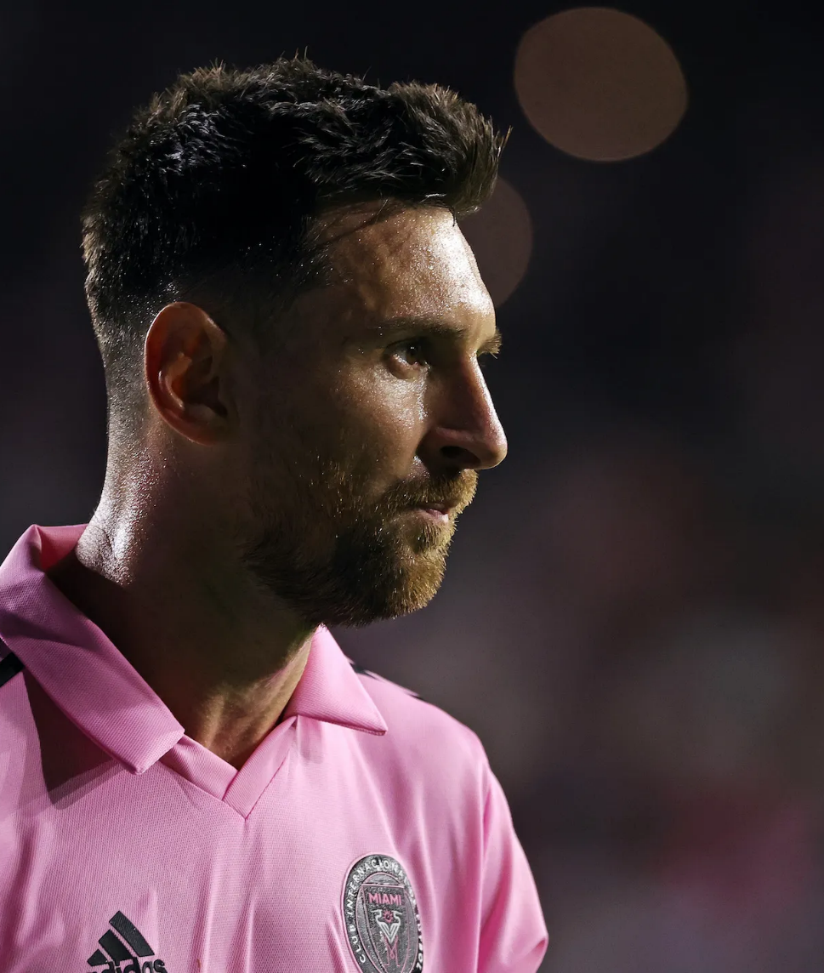
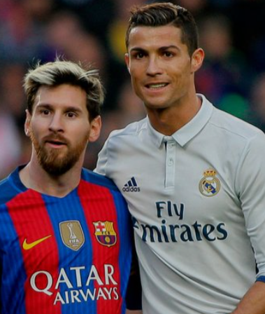
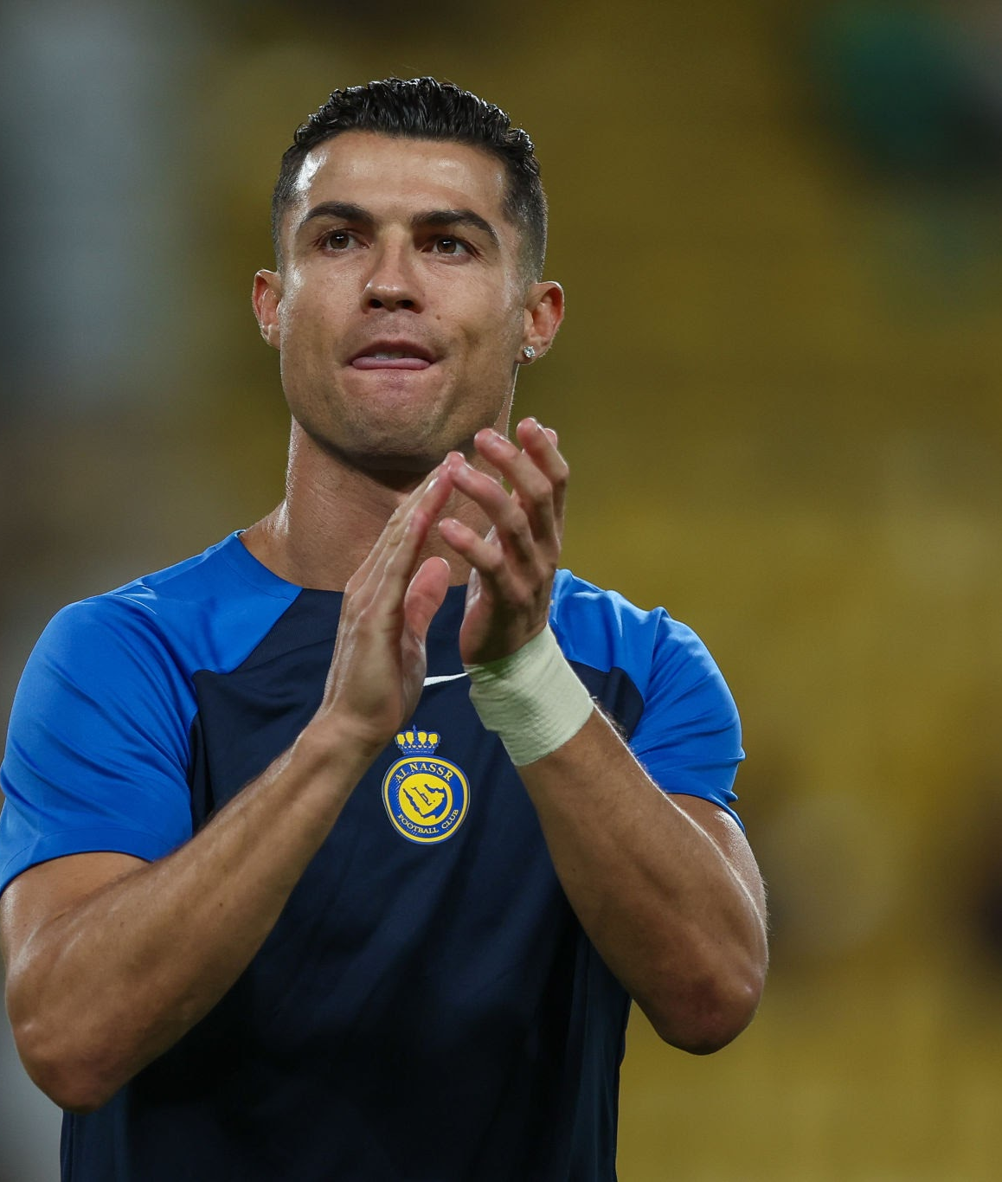
Messi – Ronaldo
A comparison between Messi and Ronaldo in Europe

Slide 2
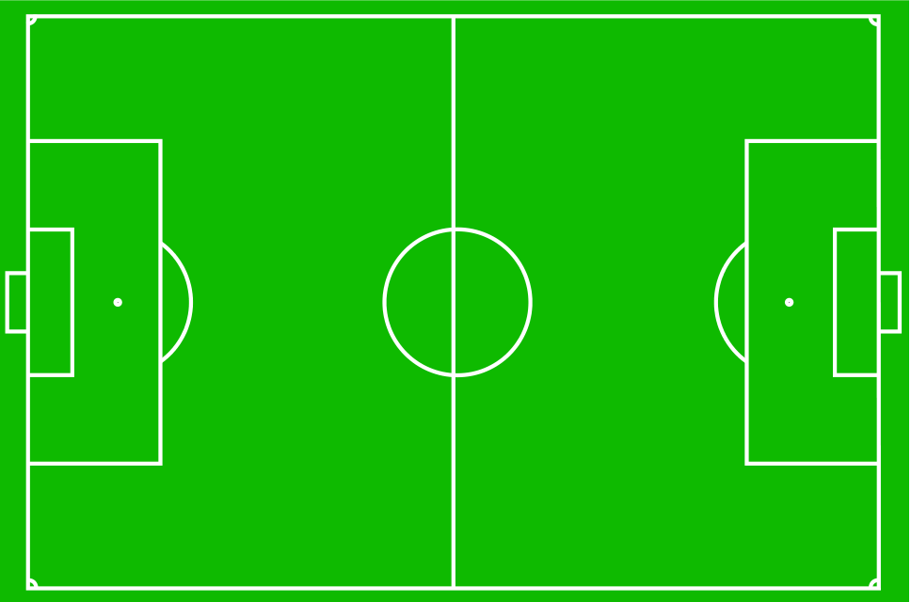
Agenda:
- Introduction
- Objective
- Ronaldo
- Messi
- Comparison Between Messi – Ronaldo
- Any Question & Thank You

Slide 3
Introduction To Messi – Ronaldo Comparison
Messi and Ronaldo are football players.
This data set talks about Messi and Ronaldo from the beginning of their football careers with the clubs until the end of 2023.
This data sets the goals of Ronaldo and Messi with all the clubs they played for until the end of 2023.
We Want to Know Some Data about Messi and Ronaldo and Compare Between Messi and Ronaldo.

Slide 4
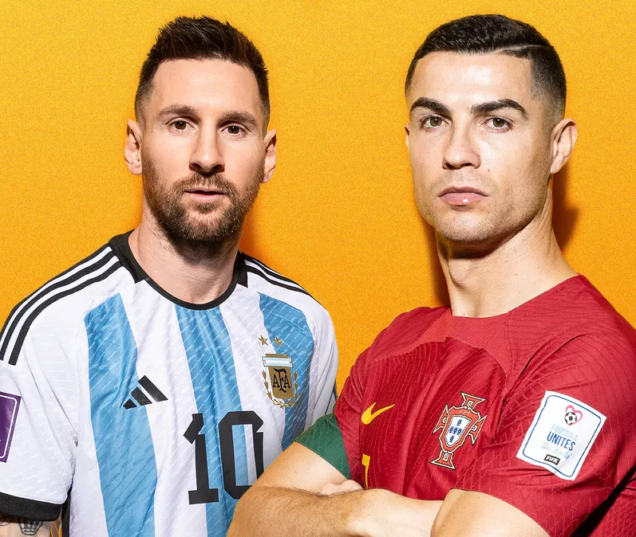
Objectives
If you want to Make A Team, would you choose Cristiano or Messi?

Slide 5
Ronaldo
Ronaldo : (Cristiano Ronaldo dos Santos Aveiro) is a Portuguese footballer
He was born in 1985 (39 years old). He played for many clubs, such as Manchester United, Juventus, Real Madrid, Sporting of Portugal, and Al-Nassr of Saudi Arabia.
He won 5 Ballon d’Or (golden balls), 5 Champions League and 0 world cup
He plays in CF, LW , RW , SS

Slide 6
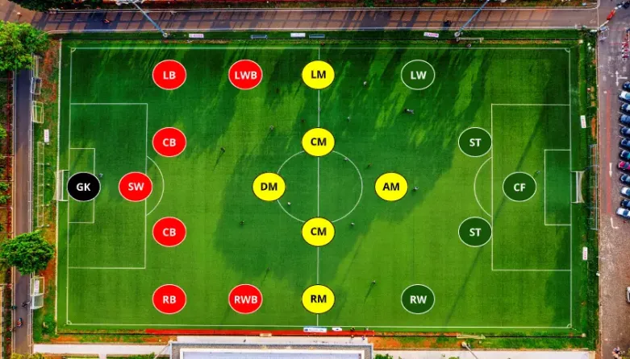

Slide 7
Messi
Messi : (of Lionel Andrés Messi ) is a Argentine footballer
He was born in 1987 (36 years old). He played for many clubs, such as Barcelona, ​​Paris Saint-Germain and Inter Miami.
He won 8 Ballon d’Or (golden balls), 4 Champions League and 1 world cup
He plays in CF, LW , RW , SS, AM

Slide 9
Introduction To Messi And Ronaldo
Messi | Ronaldo | Statistics from birth to 2022
Messi is an Argentine professional footballer who plays as a forward for Ligue 1 club Paris Saint-Germain and captains the Argentina national team. | Ronaldo is a Portuguese professional footballer who plays as a forward for Premier League club Manchester United and captains the Portugal national team. | Information
June 24, 1987 (age 36 years), Rosario, Argentina | February 5, 1985 (age 39 years), Hospital Dr. Nélio Mendonça, Funchal, Portugal | Born
1.69 m | 1.87 m | Height
Antonela Roccuzzo (m. 2017) | Georgina Rodríguez (2017) | Partner
41 million USD (2022) | 26.52 million GBP (2022) | Salary
Mateo Messi Roccuzzo, Thiago Messi Roccuzzo, Ciro Messi Roccuzzo | Cristiano Ronaldo Jr., Alana Martina dos Santos Aveiro, Eva Maria Dos Santos, Mateo Ronaldo | Children

Slide 10
Introduction To Messi And Ronaldo
Statistics so far 2023
Messi | Champion | Ronaldo
1 | كأس العالم | 0
1 | اليورو / كوبا أمريكا | 1
1 | الأولمبياد | 0
1 | كأس العالم للشباب | 0
12 | الدوريات | 7
4 | دوري أبطال أوروبا | 5
3 | كأس العالم للأندية | 4
8 | الكؤوس المحلية | 6
9 | كؤوس السوبر المحلية | 7
3 | كأس السوبر الأوروبية | 3
0 | البطولة العربية للأندية | 1
1 | كأس الدوريات الأمريكية | 0
45 | Total | 35

Slide 11
Introduction To Messi And Ronaldo
Statistics so far 2023
Messi | individual awards | Ronaldo
8 | الكرة الذهبية | 5
3 | جائزة الفيفا الأفضل | 2
6 | الحذاء الذهبي الأوروبي | 4
2 | الكرة الذهبية لكأس العالم | 0
3 | أفضل لاعب في أوروبا | 4
15 | فريق فيفبرو | 14
6 | أفضل لاعب في الدوري | 4

Slide 12
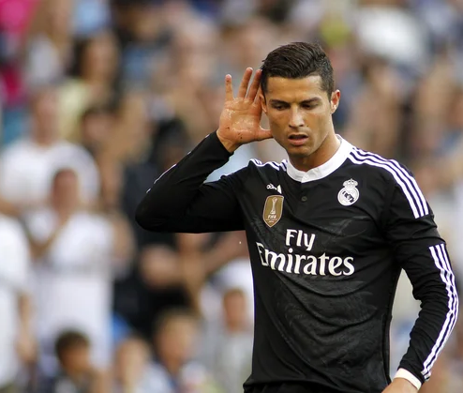
R o n a l d o (CR7)

Slide 13
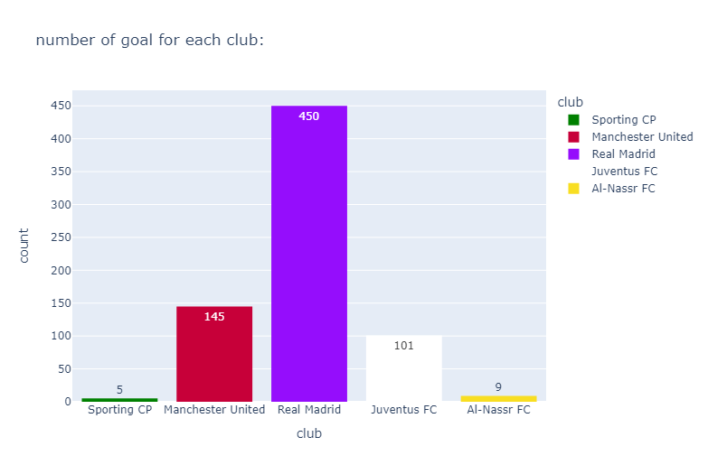
Statistics of Ronaldo's goals with clubs
We see that Real Madrid is the period of Cristiano Ronaldo's brilliance(توهج), as he spent 9 seasons with Real Madrid and Score 450 Goal

Slide 14
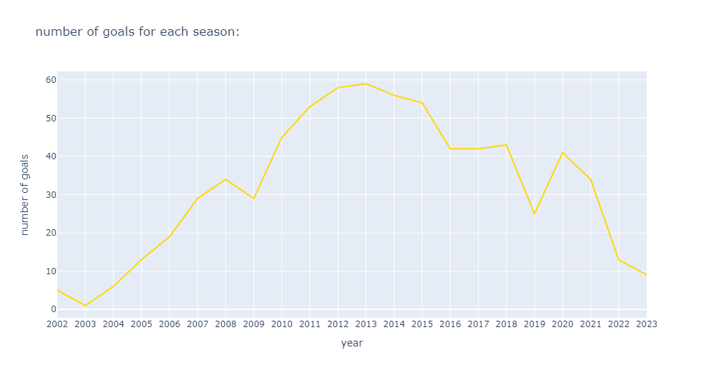
Statistics of Ronaldo's goals each year
Ronaldo started playing football with Sporting Club in Portugal season 2002/2003
We see that from 2011 to 2015 is the distinguished period for Cristiano Ronaldo, and that was in Real Madrid.
Ronaldo is still playing football for Al-Nasr Saudi Arabia (2023/2024).

Slide 15
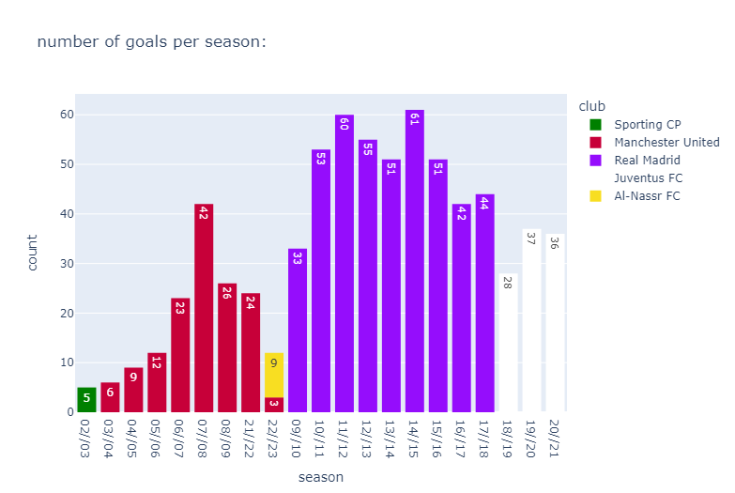
Statistics of Ronaldo's goals each season
In the 2014/2015 season, it was the season in which Ronaldo scored the most goals with the clubs, which at the time was Real Madrid. (61 Goal)

Slide 16
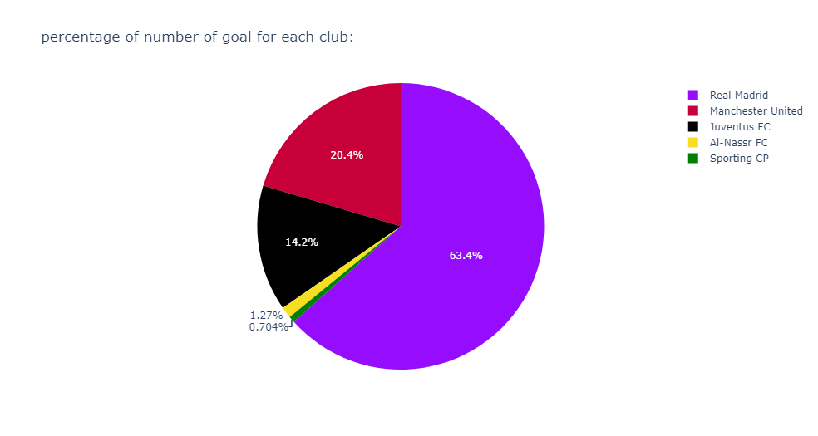
percentage of Ronaldo's goals each club
In this chart we see that more than half of Ronaldo's goals were for Real Madrid (63.4%)

Slide 17
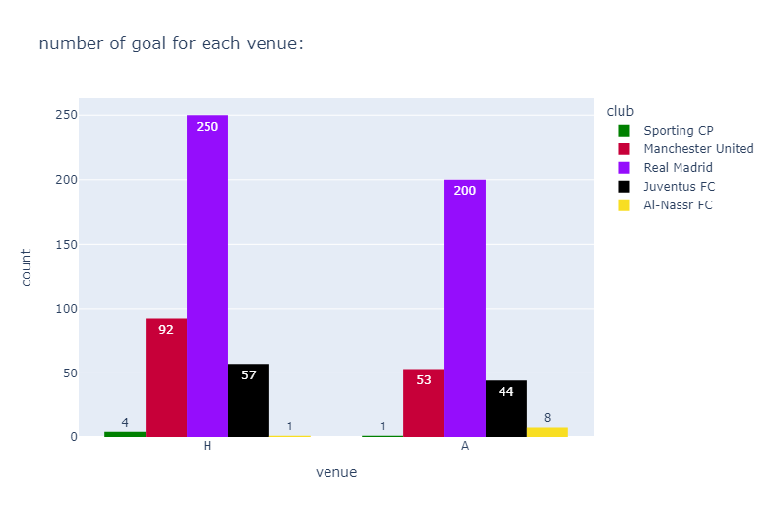
Statistics of Ronaldo's goals with clubs (Home - Away)
We see from this chart that Cristiano was more dangerous when he was playing at home, as he scored 250 goals with Real Madrid at the Santiago Bernabeu Stadium, which is more than the 200 goals he scored away from home.

Slide 18
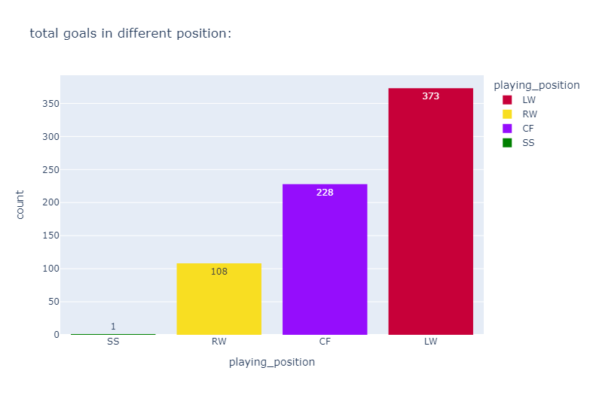
Statistics of Ronaldo's goals each Position
In this chart we see that Ronaldo scored 373 goals in the LW position and in the CF position with 228 goals, which are the two positions in which Ronaldo scored the most goals.

Slide 19
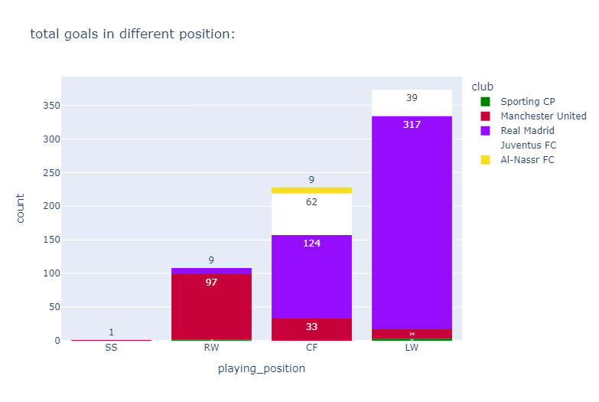
Statistics of Ronaldo's goals each position in deferent club
In this chart we see that Real Madrid and Juventus are the two clubs that have Cristiano Ronaldo players in the LW (317-39) and CF (124-62) positions.

Slide 20
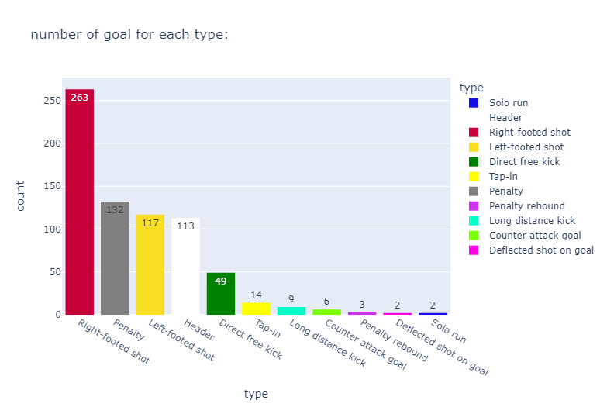
Statistics of Ronaldo's goals each year
In this chart we see that Ronaldo scored (263) goals with his right foot, which is (117) more than his left foot, and that statistic was in the goals he scored apart from penalty kick goals, etc.

Slide 21
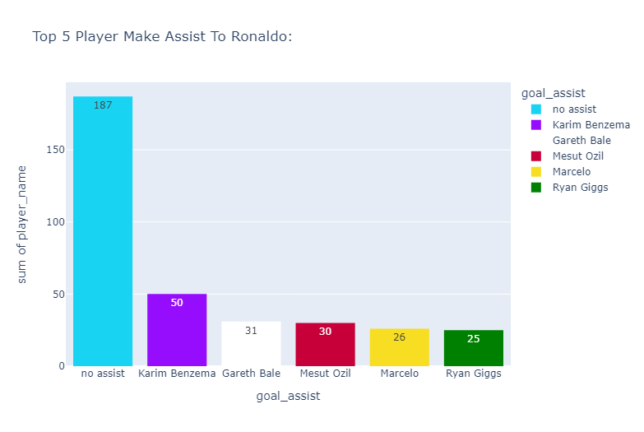
The five players who made the most for Ronaldo
no assist when the goal is scored from a penalty, penalty rebound, free kick, or solo run
Karim Benzema came in first place for assisting Cristiano Ronaldo (50 assists), and second place was taken by Gareth Bale (31 assists).

Slide 22
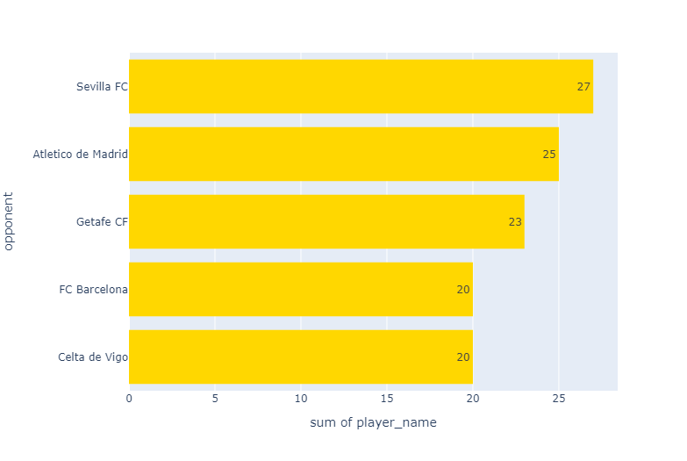
The five most victimized clubs of Ronaldo
We see in this chart that Sevilla FC club that Ronaldo used to score the most with, with (27) goals. Atletico Madrid comes in second place with (25) goals, while Barcelona, ​​Real Madrid's traditional rival, ranks fourth with (20) goals.

Slide 23
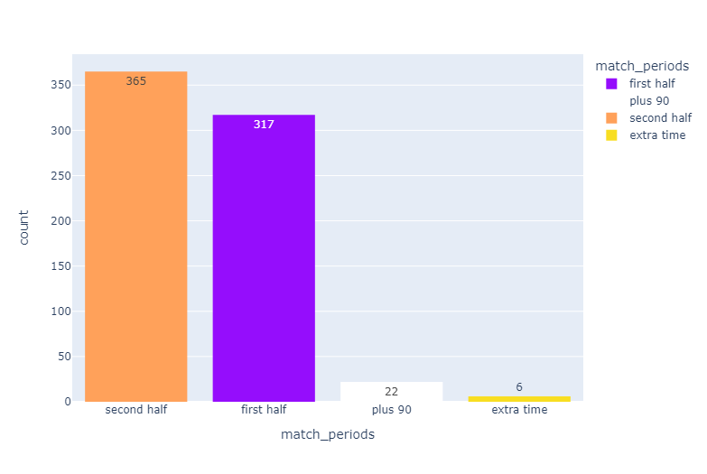
Most times Cristiano Ronaldo has scored
We see in this chart that Ronaldo was more influential in the second half (365) goals than in the first half (317) goals.

Slide 24
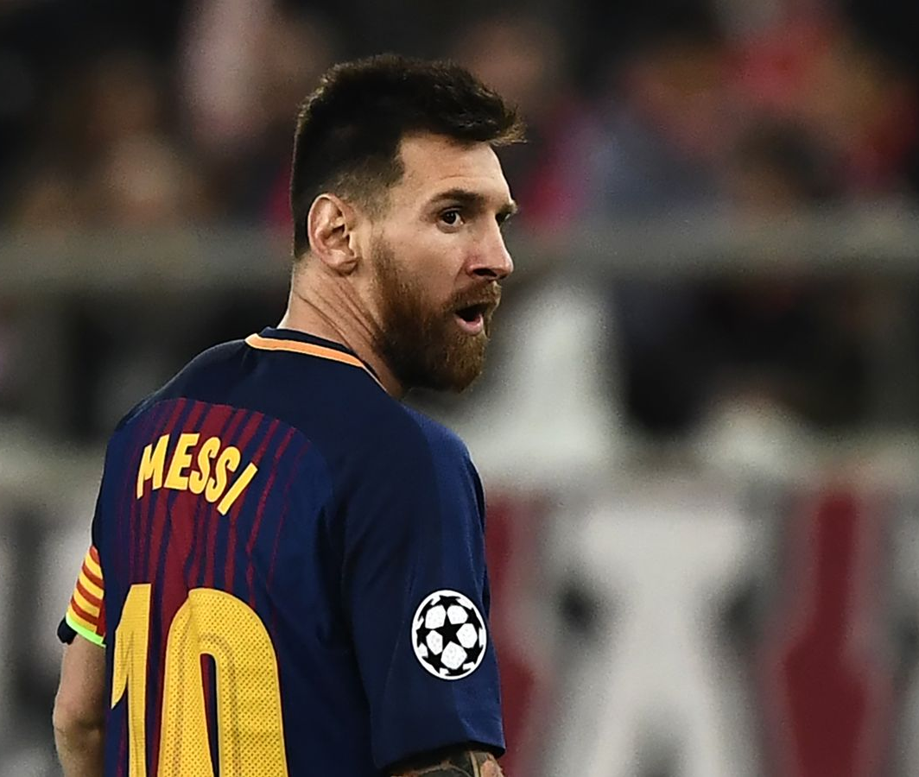
M e s s i

Slide 25
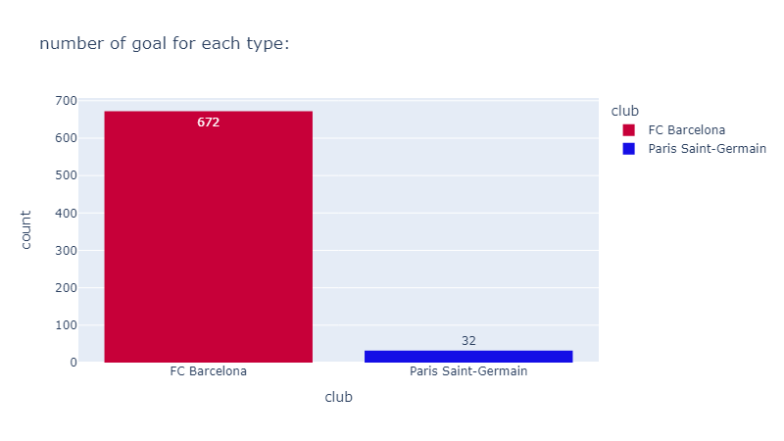
Statistics of Messi's goals with clubs
We see that Barcelona FC is the period of Messi brilliance(توهج), as he spent 17 season with Barcelona FC and Score 672 Goal

Slide 26
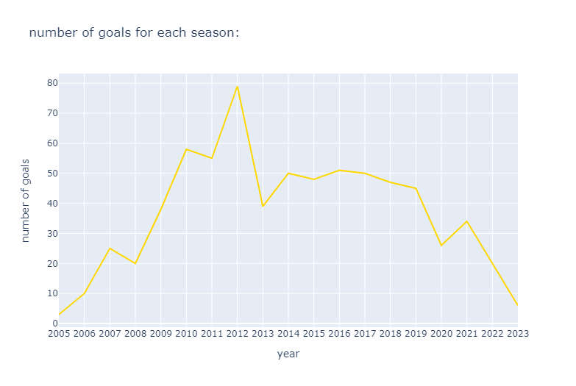
Statistics of Messi's goals each year
Messi started playing football with Barcelona FC Club in Spain season 2005/2006
Messi is still playing football in Inter Miami.
We see that from 2009 to 2018 is the distinguished period for Messi, and that was in Barcelona FC Club.

Slide 27
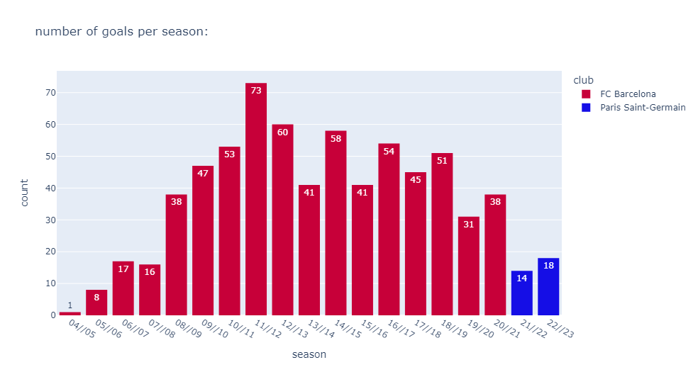
Statistics of Messi's goals each sEASON
In the 2011/2012 season, it was the season in which Messi scored the most goals with the clubs, which at the time was Barcelona. (73 Goal)

Slide 28
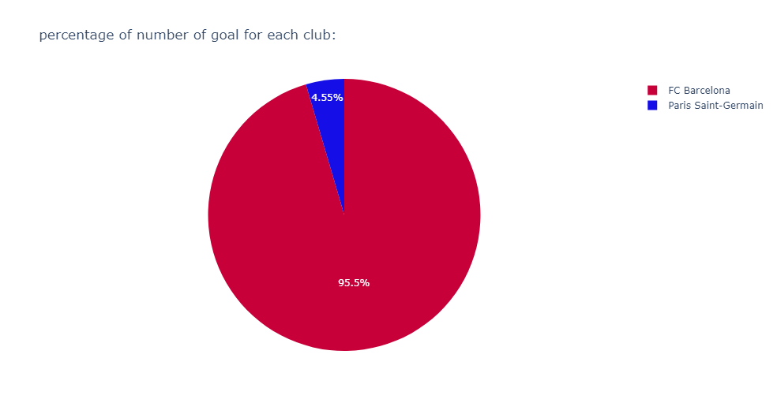
percentage of Messi's goals each club
In this plot we see that more than half of Messi's goals were for Barcelona FC (95.5%)

Slide 29
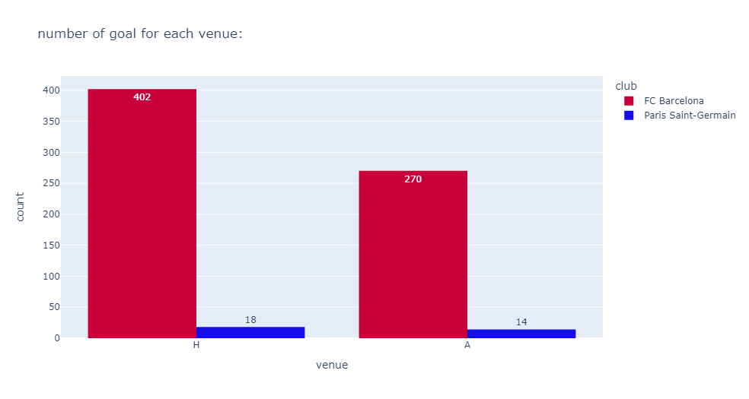
Statistics of Messi's goals with clubs (Home - Away)
We see from this plot that Messi was more dangerous when he was playing at home, as he scored 402 goals with Barcelona FC at the Camp Nou Stadium, which is more than the 270 goals he scored away from home.

Slide 30
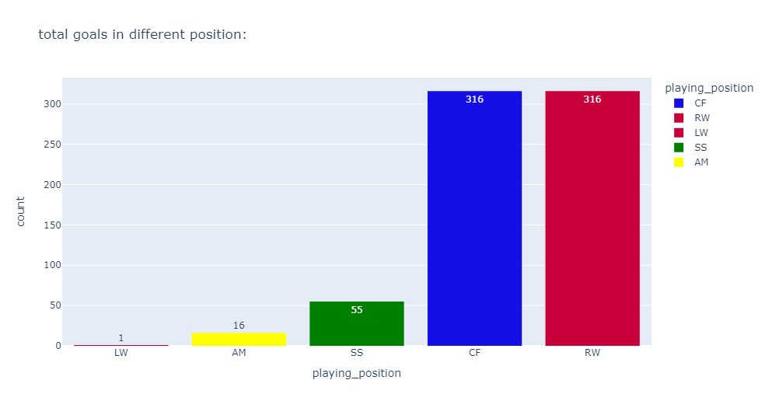
Statistics of Messi's goals each position
In this chart we see that Messi scored 316 goals in the RW position and in the CF position with 316 goals, which are the two positions in which Messi scored the most goals.

Slide 31
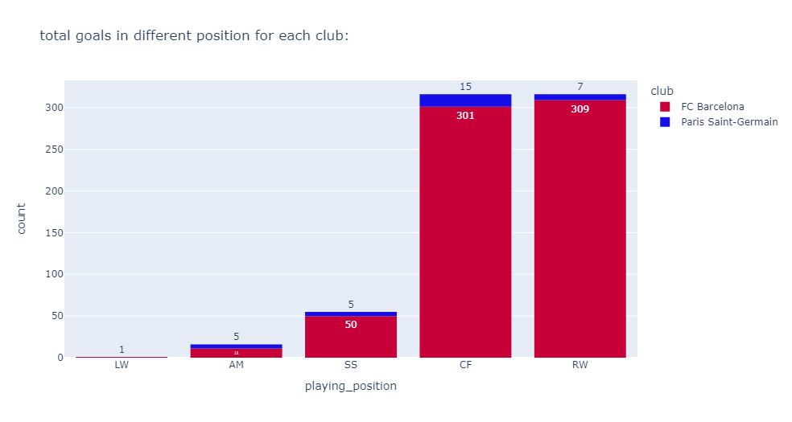
Statistics of Messi's goals each Position for each club
In this plot we see that Barcelona benefited from Messi in the RW and CF positions. Where he scored (309) goal in RW and (301) goal in CF

Slide 32
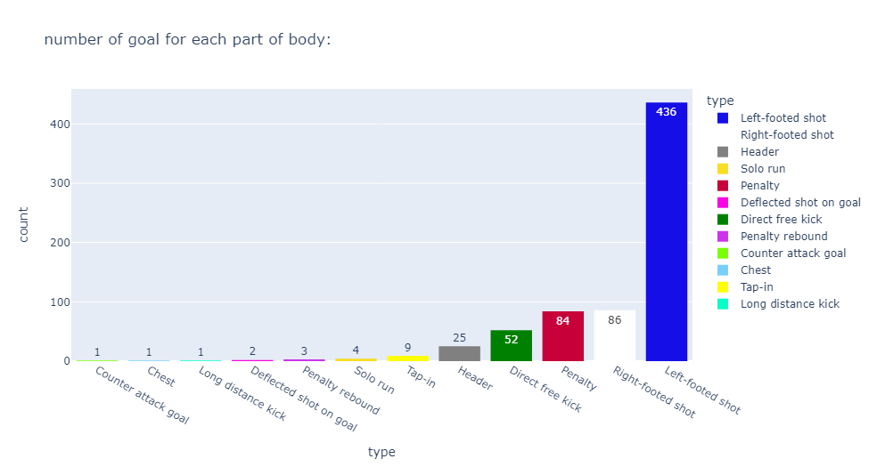
Statistics of Messi's goals for each part of body
In this chart we see that Messi scored (436) goals with his left foot, which is (86) more than his right foot, and that statistic was in the goals he scored apart from penalty kick goals, etc.

Slide 33
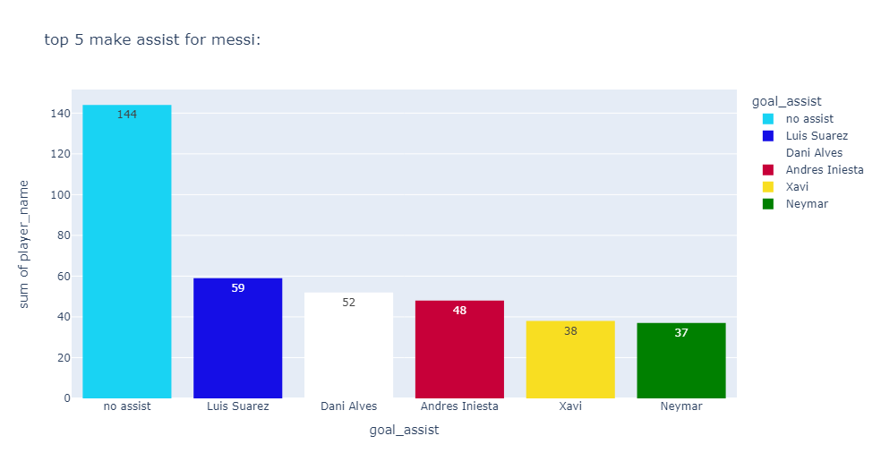
The five players who made the most for Messi
no assist when the goal is scored from a penalty, penalty rebound, free kick, or solo run
Luiz Suarez came in first place for assisting Messi (59 assists), and second place was taken by Dani Alves (52 assists).

Slide 34
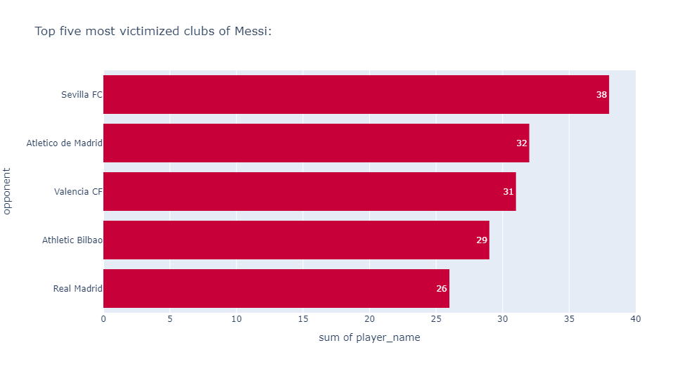
Top five most victimized clubs of Messi
We see in this chart that Sevilla FC club that Ronaldo used to score the most with, with (38) goals. Atletico Madrid comes in second place with (32) goals, while Real Madrid, Barcelona's traditional rival, ranks fifth with (26) goals.

Slide 35
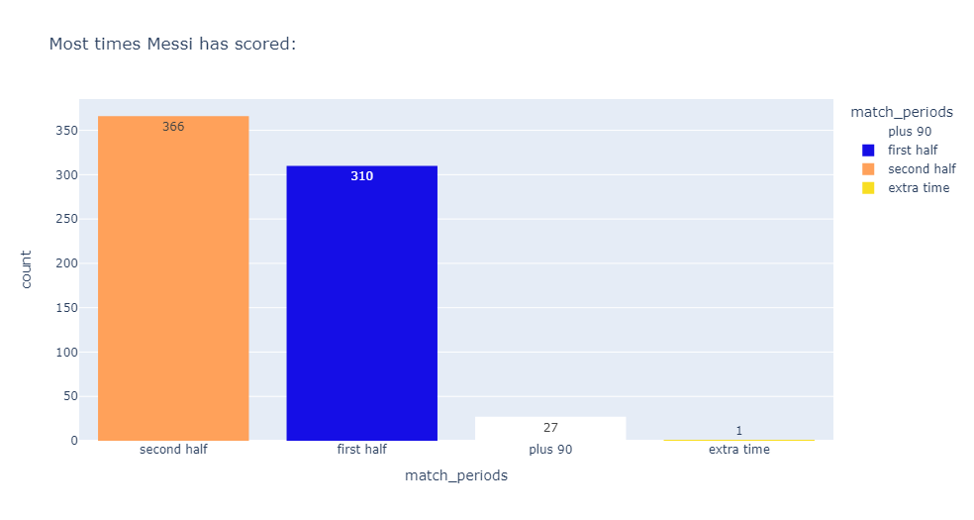
Most times Messi has scored
We see in this chart that Messi was more influential in the second half (366) goals than in the first half (310) goals.

Slide 36

Comparison between Messi and Ronaldo

Slide 37
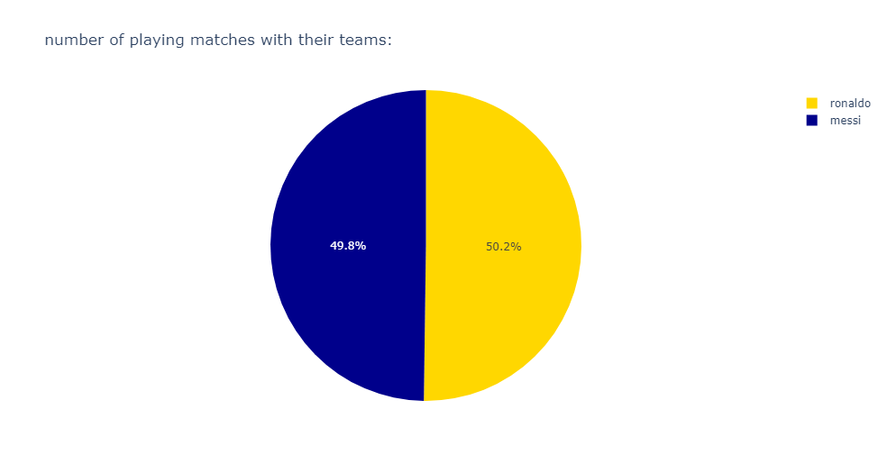
percentage of matches in which each player scored for his club
Percentage of matches in which each player scored for his club: - Messi 49.8 - Ronaldo 50.2

Slide 38
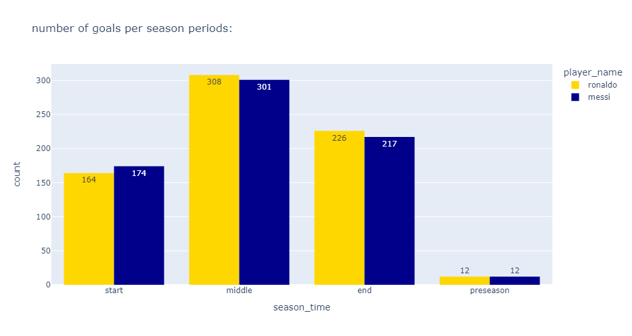
The contributions of each player throughout the season
From this plot, we see that Messi surpasses Cristiano in the number of goals scored at the beginning of the season (Messi 174 – Ronaldo 164), while Cristiano surpasses Messi at the end of the season and the middle of the season. (Messi 301 , 217 - Ronaldo 308, 226)

Slide 39
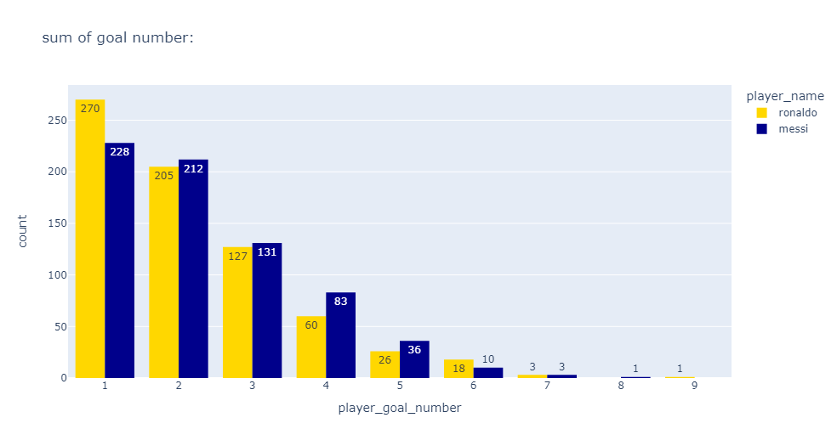
Goal number scored by Cristiano and Messi
Through this chart, we see that Ronaldo scored the first goal (270) for his team more often than Messi (228) and made the task easier for his team.

Slide 40
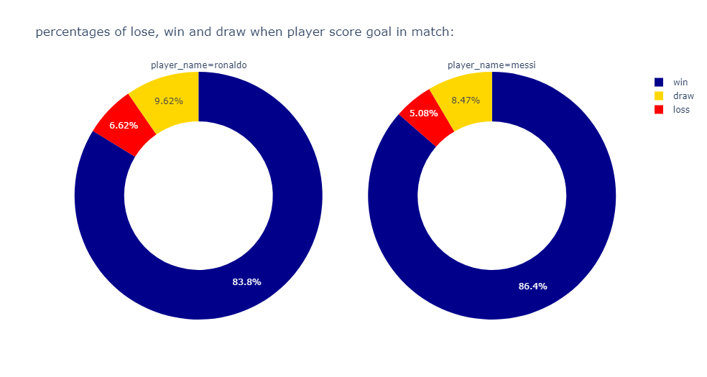
Statistics when Ronaldo and Messi score a goal and their impact on the outcome of the match
We see from this chart that Messi's percentage (86.4%) is higher than Cristiano’s (83.8%) when Messi and Cristiano score goals, while Ronaldo's percentage (6.62%) is higher than Messi (5.08%)in draws.

Slide 41
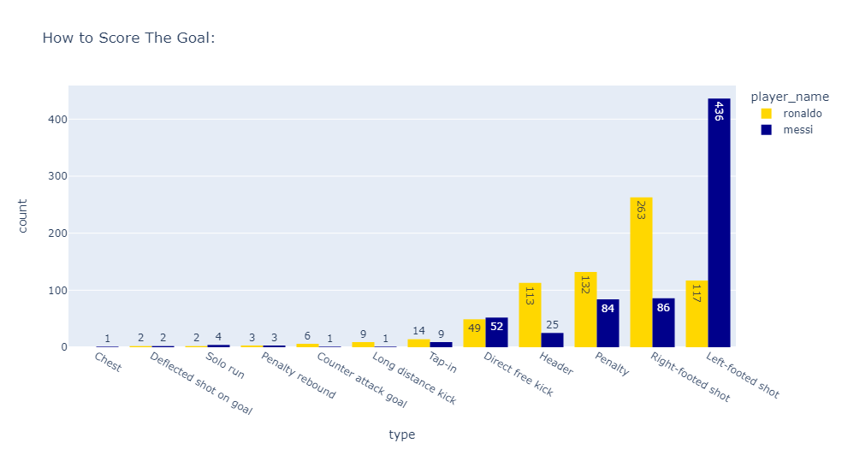
How to score a goal for each player
in this plot, we see that Messi is far superior to Cristiano when using his left foot to score goals (Messi 436 – Ronaldo 117), while Cristiano is superior when playing with his right foot, headers, and penalty kicks. (Ronaldo 263, 113,132 – Messi 86, 25, 84)

Slide 42
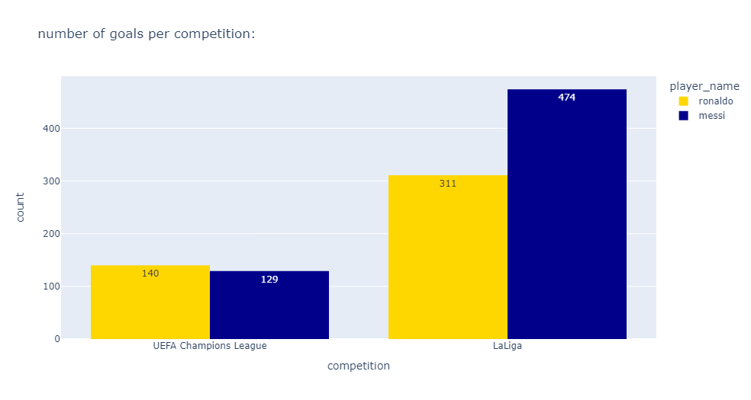
Statistics of Number of goals Ronaldo and Messi in champions league and LaLiga
We see from the plot that in the Champions League, Cristiano (140) is superior to Messi (129), while Messi (474) is superior to Cristiano (311) in LaLiga.

Slide 43
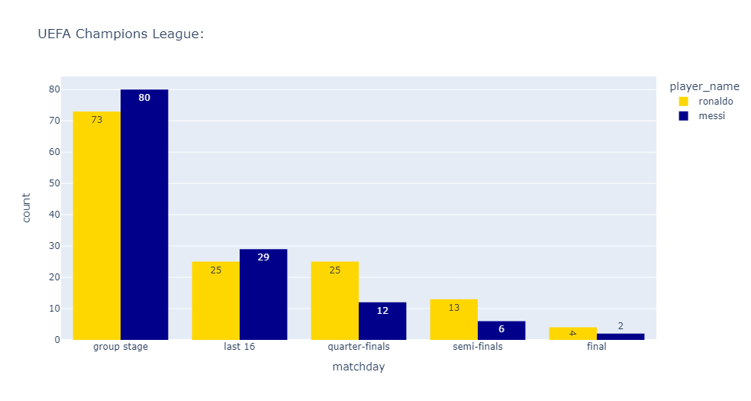
Number of goals scored by each player in the Champions League
We see that in the round of 16 and group stage, Messi (80-29) outperforms Cristiano(73-25), while in the important knockout rounds, such as the quarter-finals, semi-finals and finals, Cristiano (25-13-4) outperforms Messi (12-6-2) and has an important presence.

Slide 44
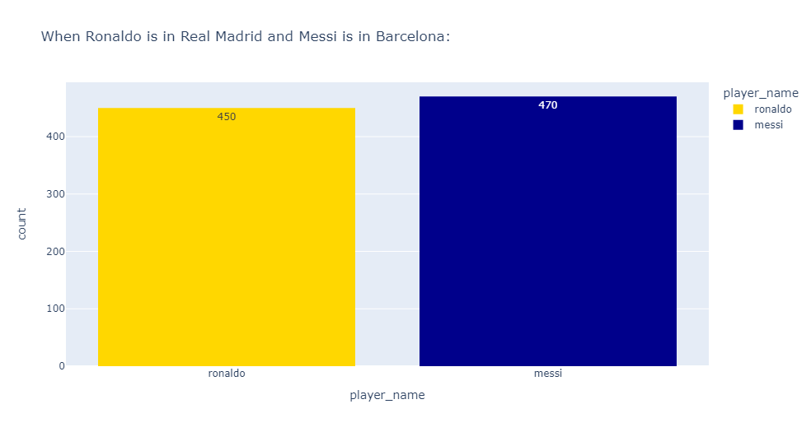
Statistics of Ronaldo in Real Madrid and Messi in Barcelona
We see through this plot that the number of Ronaldo’s (450) goals with Real Madrid and the number of Messi’s (470) goals with Barcelona, ​​and we see that Messi is superior to Cristiano.

Slide 45
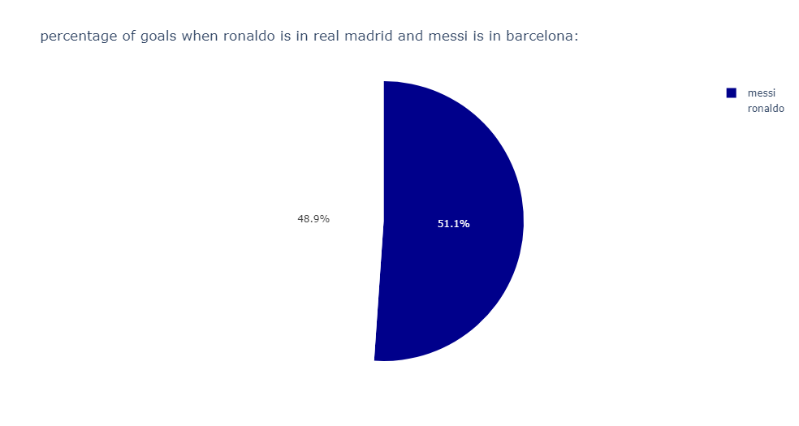
Statistics of Ronaldo goals In Real Madrid and Messi in Barcelona
We see from this chart that Messi (51.1%) has the highest goal scoring rate than Cristiano(48.9%).

Slide 46
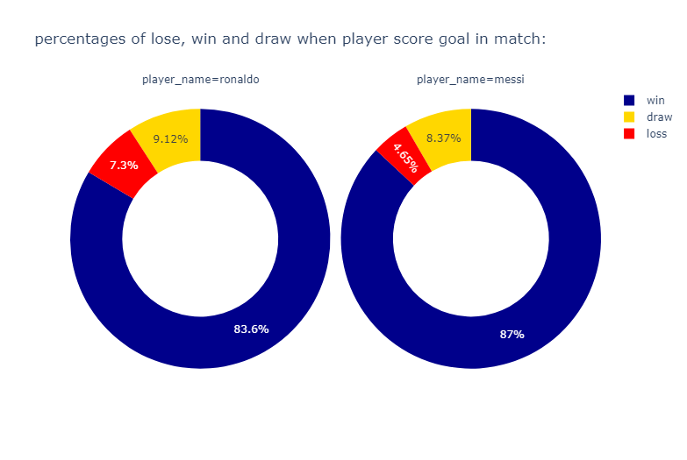
Statistics of Ronaldo goals In Real Madrid and Messi in Barcelona
We see from this plot that Barcelona's win percentage when Messi (87%) scores is greater than Real Madrid's win percentage when Ronaldo (83.6%) scores, while the draw percentage is in Ronaldo’s (9.12%) favor over Messi’s(8.37%).

Slide 47
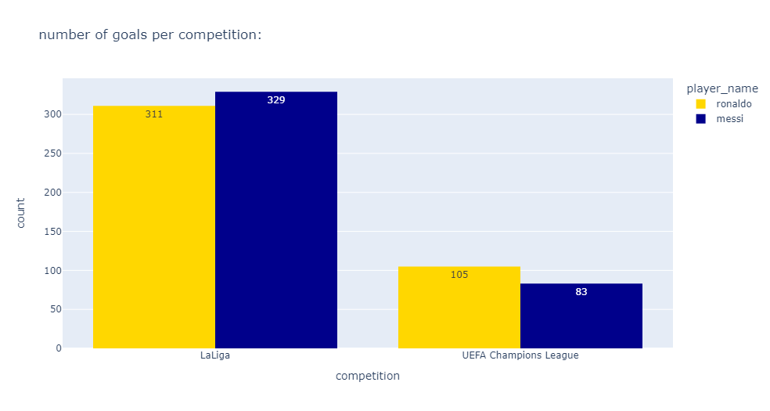
numbers of Ronaldo's goals with Real Madrid and Messi for Barcelona in the Champions League and LaLiga
We see from the plot that in the Champions League, Cristiano (105) is superior to Messi (83), while Messi (329) is superior to Cristiano (311) in LaLiga.

Slide 48
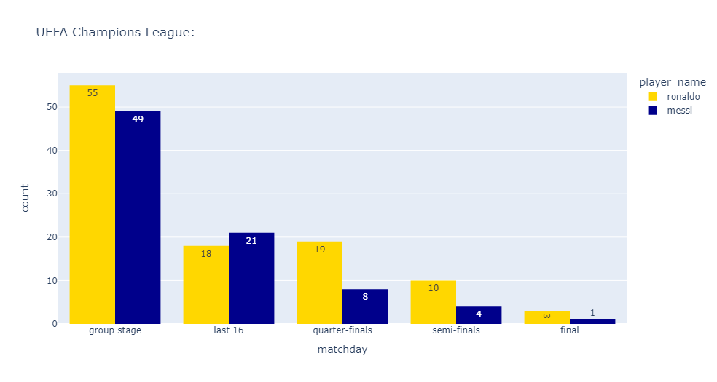
Number of goals scored by each player in the Champions League when Ronaldo in real Madrid and Messi in Barcelona
We see that in the round of 16 stage, Messi (21) outperforms Cristiano(18), while in the important knockout rounds, such as the group stage and quarter-finals, semi-finals and finals, Cristiano (55-19-10-3) outperforms Messi (49-8-4-1) and has an important presence.

Slide 49

Any Question?

Slide 50

Thank You

